Slide 1


Slide 2
Recap:
What topics did we cover in our 2022 Sessions?

Slide 3
Exploratory
Data Analysis

Slide 4

Introduction
What comes to mind when you hear EDA?

Slide 5
Introduction
What makes data “good”?

Slide 6
Introduction
P
P
A

Slide 7
Introduction
Profile
Prepare
Analyze

Slide 8
Introduction: Profiling
Structure Discovery
Content
Discovery
Identify the structure of your dataset(s):
How many data points/samples
How many columns
What type of data is each column?
What are the names of each column?
What does each column represent?
Investigates the quality of individual pieces of data:
Are there any missing values?
Are there any ambiguous values?

Slide 9
Profile
Profile
Prepare
Analyze

Slide 10
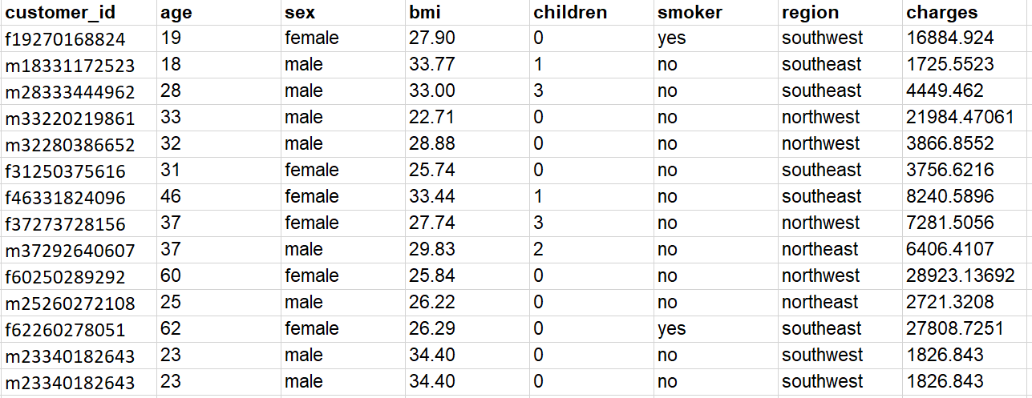
Profile
Identify the structure of your dataset(s):
How many data points/samples
How many columns
What type of data is each column?
What are the names of each column?
What does each column represent?

Slide 11
Profile
Investigates the quality of individual pieces of data:
Are there any missing values?
Are there any ambiguous values?

Slide 12

Profile
COMMON DATA ISSUES TO WATCH OUT FOR:
Inconsistent Column Names
Improper Data Types
Duplicates
Inconsistent Labels
Single-Value columns (and low-variability columns)
Missing Data

Slide 13
Profile
Inconsistent column names
All columns in the dataset should be properly labeled to describe its values.
Incorrect
Class Column
Bar,code
V1
Invoice - Date

Slide 14
Profile
Improper data types and format
Ensure that each column is converted into proper format and data type.
Column | Format | Type
transaction_date | “12-31-2019” | String
amount | $1,000.50 | Ambiguous

Slide 15
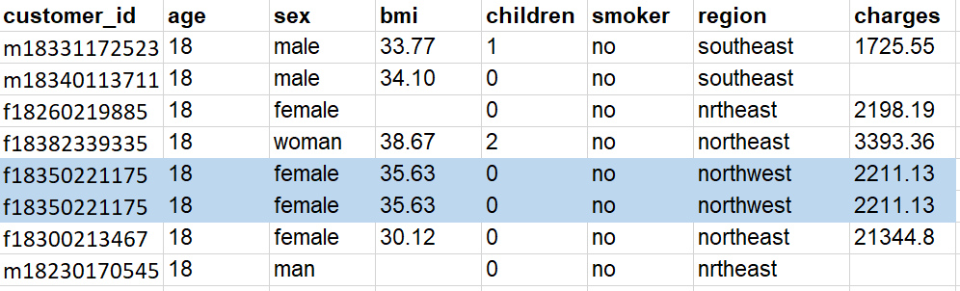
Profile
Duplicates

Slide 16
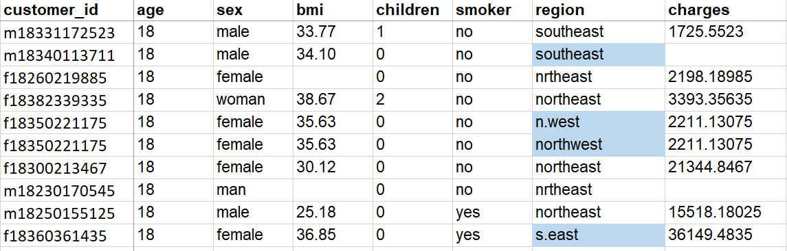
Profile
Inconsistent labels
Category labels should be consistent throughout the dataset.
There should be unique representation of each category.

Slide 17
Profile
Inconsistent labels
Category labels should be consistent throughout the dataset.
There should be unique representation of each category.
Student_Name | Computer_Type | Brand
John | PC | APPLE
Sarah | Personal Computer | lenovo
Jennifer | pc | Apple

Slide 18
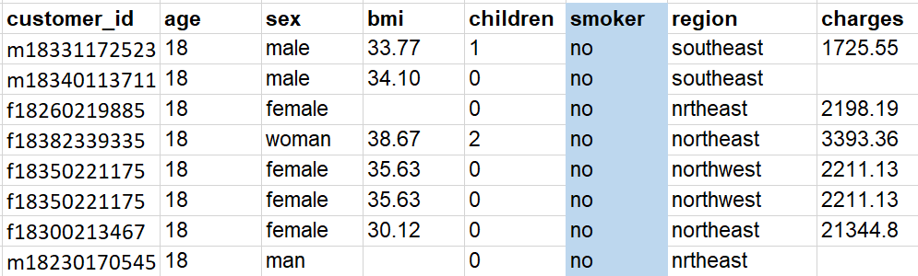
Profile
Single Value Columns

Slide 19
Profile
Low variability in values
Numerical columns that have low variance can (generally) also be discarded. They carry little information.
Transaction_ID | Location | Amount | Currency
001 | Manila | 10 | USD
002 | Manila | 10 | USD
003 | Manila | 20 | USD
004 | Manila | 10 | USD
005 | Ortigas | 10 | USD

Slide 20
Prepare
Profile
Prepare
Analyze

Slide 21
Prepare
Inconsistent column names
All columns in the dataset should be properly labeled to describe its values.
Incorrect
Class Column
Bar,code
V1
Invoice - Date
Correct
Class_column
Barcode
Transaction_date
Invoice_date
For your own convenience, make sure column names adhere to the standards of whatever coding language you’re using.

Slide 22
Prepare
Improper data types and format
Ensure that each column is converted into proper format and data type.
Column | Format | Type
transaction_date | “12-31-2019” | String
amount | $1,000.50 | Ambiguous
Correct Format | Correct Type
12-31-2019 | Date
1000.50 | Numerical

Slide 23
Prepare
Duplicates
Remove duplicates or redundant records.

Slide 24
Prepare
Inconsistent labels
Category labels should be consistent throughout the dataset.
There should be unique representation of each category.
Region
southeast
southwest
northeast
northwest

Slide 25
Prepare
Inconsistent labels
Category labels should be consistent throughout the dataset.
There should be unique representation of each category.
Student_Name | Computer_Type | Brand
John | PC | APPLE
Sarah | Personal Computer | lenovo
Jennifer | pc | Apple
Student_Name | Computer_Type | Brand
John | PC | Apple
Sarah | PC | Lenovo
Jennifer | PC | Apple
Correct

Slide 26
Prepare
Single Value Columns
Remove columns that have constant values. They don’t give any additional information at all.

Slide 27
Prepare
Low variability in values
Numerical columns that have low variance can (generally) also be discarded. They carry little information.
Transaction_ID | Location | Amount | Currency
001 | Manila | 10 | USD
002 | Manila | 10 | USD
003 | Manila | 20 | USD
004 | Manila | 10 | USD
005 | Ortigas | 10 | USD
EXCEPTION: Numerical values but are actually categories

Slide 28
Prepare
What about missing values?

Slide 29
Prepare
Mechanisms of Missingness
Missing…
Completely at Random (MCAR)
Reason for missing data is completely unrelated to the analysis being done, or the data that was collected.
At Random (MAR):
Reason for missing data is related to something that was observed or collected.
Not at Random (MNAR)
Reason for missing data is related to something that was not collected (but we would have wanted to collect)

Slide 30
Prepare
Mechanisms of Missingness
Missing…
Completely at Random (MCAR)
Cow at the survey forms.
At Random (MAR):
Executives are less likely to state their salary (but they do declare that they are executives).
Not at Random (MNAR)
People who earn more are less likely to state their salary.

Slide 31
Prepare
Mechanisms of Missingness
Missing…
Completely at Random (MCAR)
Generally safe to simply delete these rows.
At Random (MAR):
Generally unsafe to delete, worthwhile to explore imputation.
Not at Random (MNAR)
Generally unsafe to delete, worthwhile to explore imputation.

Slide 32
Analyze
Profile
Prepare
Analyze

Slide 33

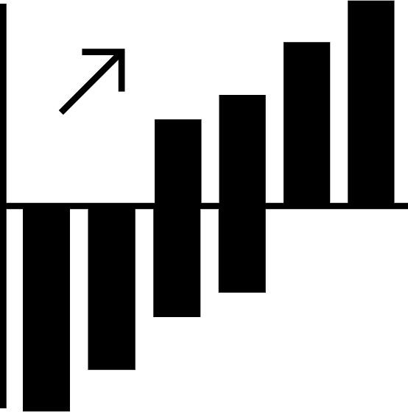
Analyze
STATISTICS
Describing, Presenting, and Analyzing Data
a
12%
Number
Table
Chart

Slide 34


Analysis
Univariate Analysis
Bivariate Analysis

Slide 35





Univariate
Summary Statistics
Average sales per transaction Average basket size
Average number of study hours of students
Average amount of loan
Average difference in house prices in NYC vs to LA.

Slide 36
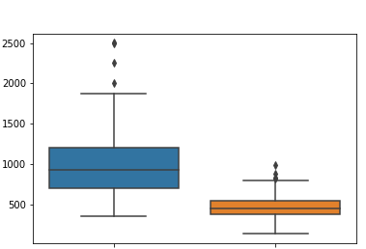
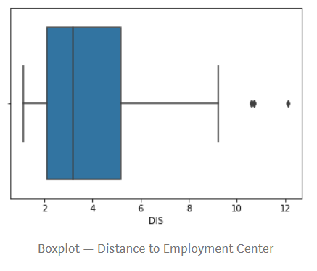
Univariate
Charts: Boxplot
Check the spread of the data. How distributed it is?
Check for outliers
Study and point out to data owners
NYC
LA
Basket size of customers (in thousands)
House prices (in thousand dollars)

Slide 37
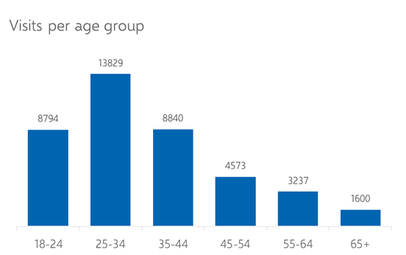
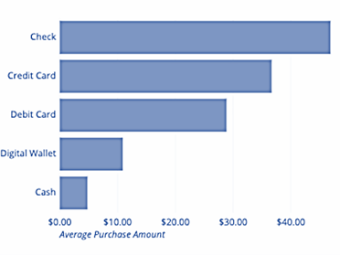
Univariate
Charts: Bar chart
Check distribution of categories
Check top/bottom categories.
Average purchase amount by payment type

Slide 38
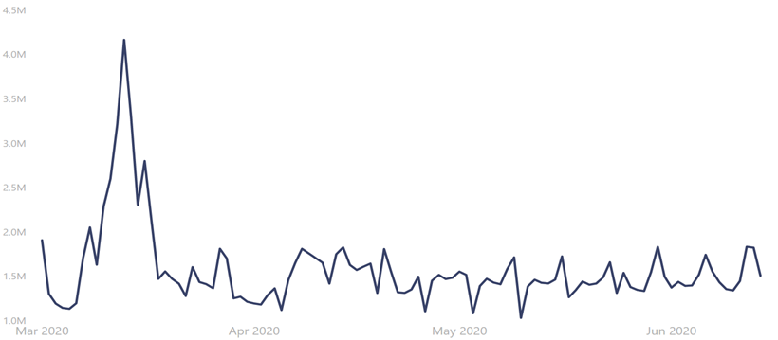
Univariate
Charts: Line chart
Inspect for trends/patterns
Number of items sold in store X

Slide 39
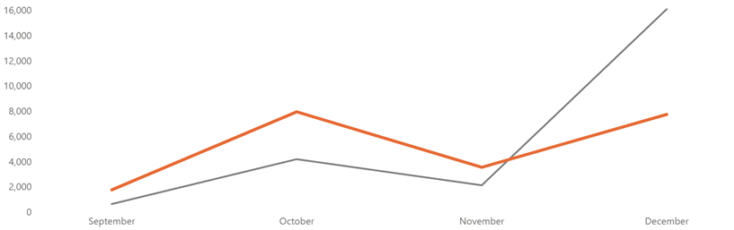
Univariate
Charts: Line chart
Compare trends
Month-on-Month number of transactions this year vs last year

Slide 40
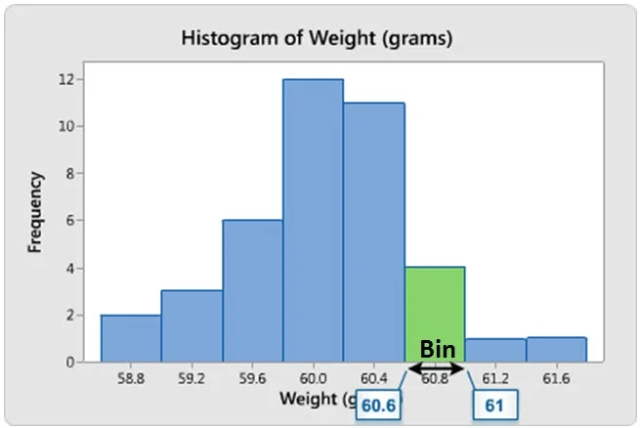
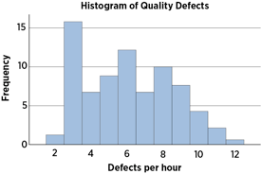
Univariate
Charts: Histogram
Check the spread of the data. How distributed it is?
Values are grouped into bins or ranges.

Slide 41
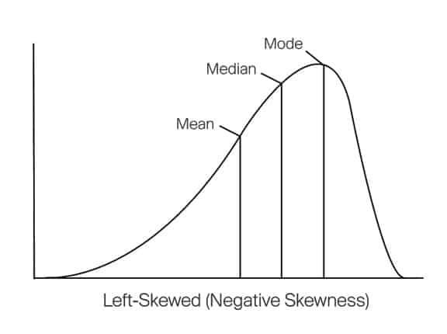
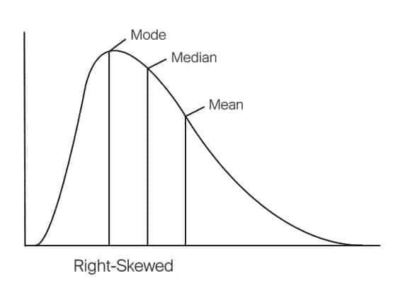
Univariate
Skewed data
What do we mean by skewed data?
Data is skewed when there are too many small values or large values.
Left skewed if there too many large values in the data.
Right skewed if there too many small values in the data.

Slide 42
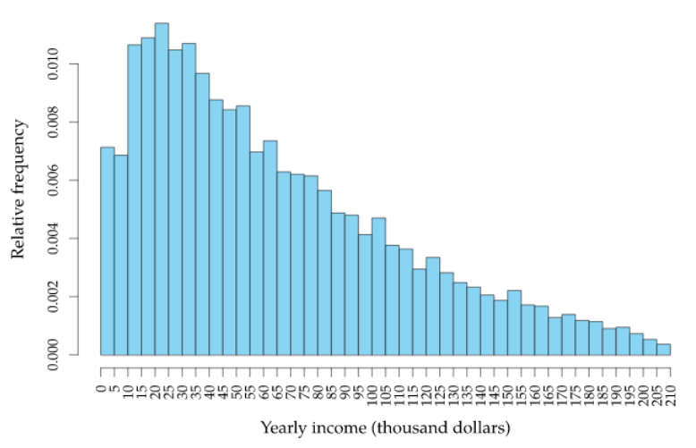
Univariate
Skewed data
Right Skewed data
The distribution tells that most of the people have incomes near to 20K dollars/year and then the number of people having higher income exponentially decreases with the increase in income.
Source: https://towardsdatascience.com/skewed-data-a-problem-to-your-statistical-model-9a6b5bb74e37#:~:text=A%20data%20is%20called%20as,as%20on%20the%20right%20side.

Slide 43
Univariate
Skewed data
Mode
Median
Mean
Source: https://towardsdatascience.com/skewed-data-a-problem-to-your-statistical-model-9a6b5bb74e37#:~:text=A%20data%20is%20called%20as,as%20on%20the%20right%20side.

Slide 44
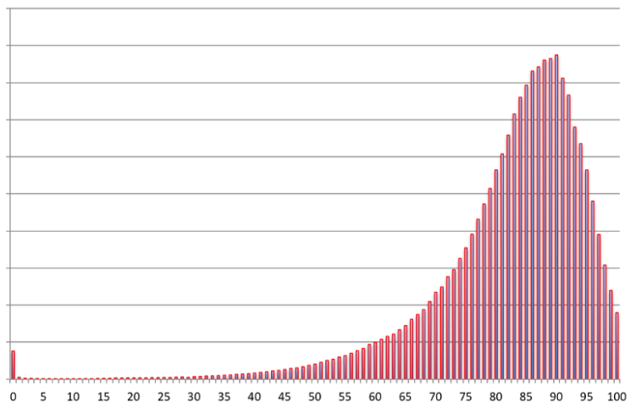
Univariate
Skewed data
Left Skewed data
The distribution tells us that most of the people die at the age of near to 90.
Frequency count
Age at death
Source: https://towardsdatascience.com/skewed-data-a-problem-to-your-statistical-model-9a6b5bb74e37#:~:text=A%20data%20is%20called%20as,as%20on%20the%20right%20side.

Slide 45
Univariate
Skewed data
Mode
Median
Mean
Frequency count
Age at death
Source: https://towardsdatascience.com/skewed-data-a-problem-to-your-statistical-model-9a6b5bb74e37#:~:text=A%20data%20is%20called%20as,as%20on%20the%20right%20side.

Slide 46
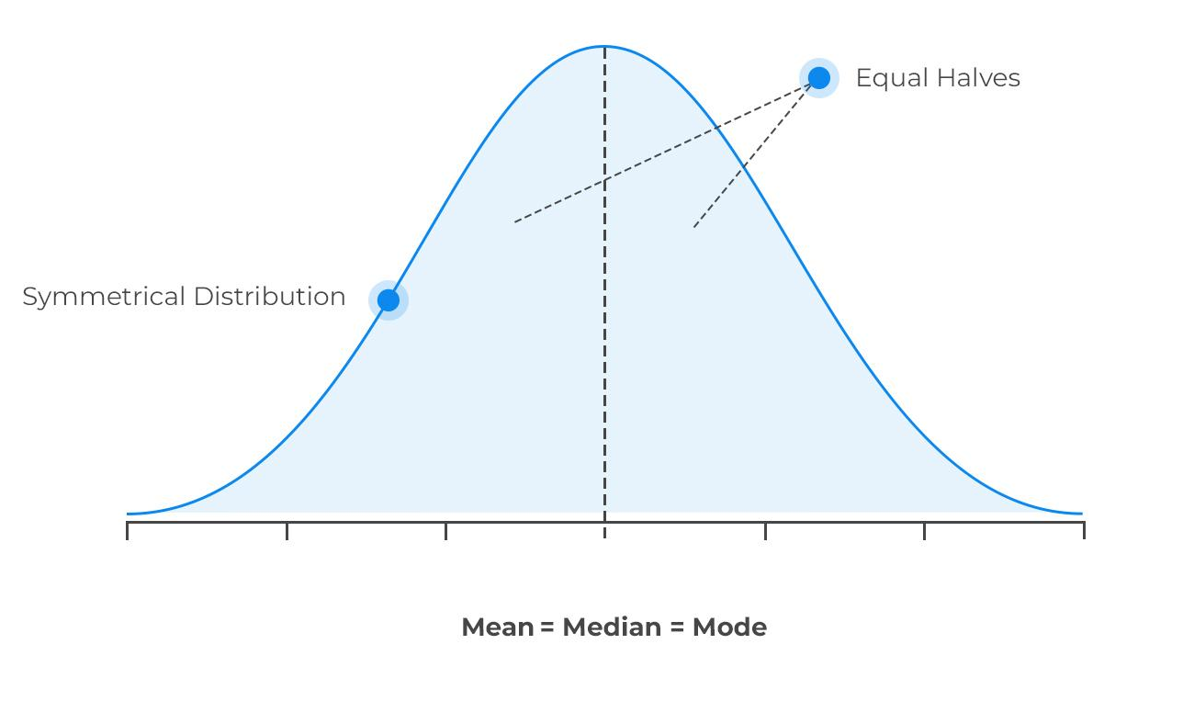
Univariate
Skewed data
Why skewness is an issue?
Most statistical models assume a normal or Gaussian distribution. If data is skewed,
Some statistical models won’t work as expected.
Observations in the tail are sometimes detected as outliers.

Slide 47
The cycle begins…
Profile
Prepare
Analyze
(again)

Slide 48
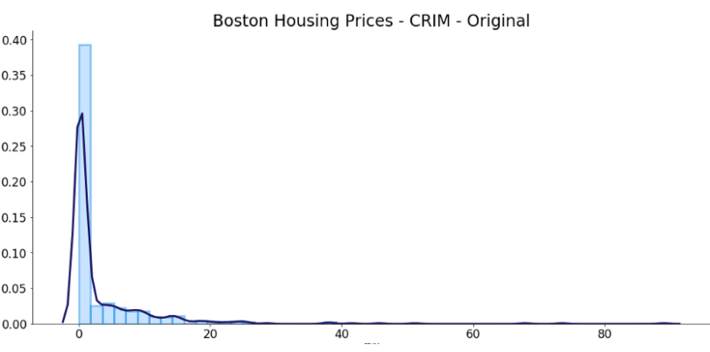
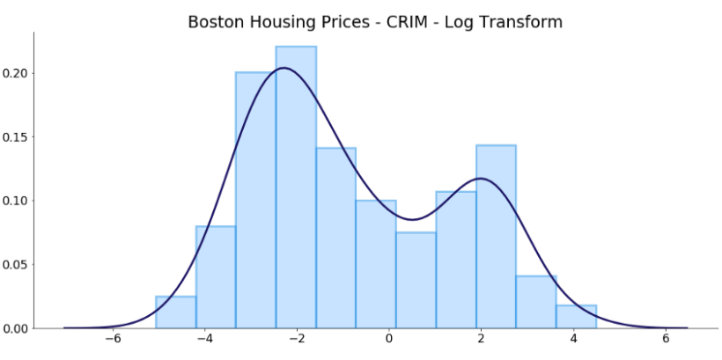
Prepare (Again)
Skewed data
How to deal with skewed data?
Log transform
Square root transform
np.log()
np.sqrt()

Slide 49
Prepare (Again)
Outliers
1 Remove
Value
Variable
2 Remove and study them separately
Studying the outlier might give a different perspective or prompts an opportunity.
3 Assign a new value
Use imputation techniques to replace the value of the outlier.

Slide 50
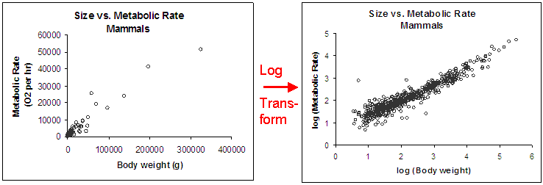
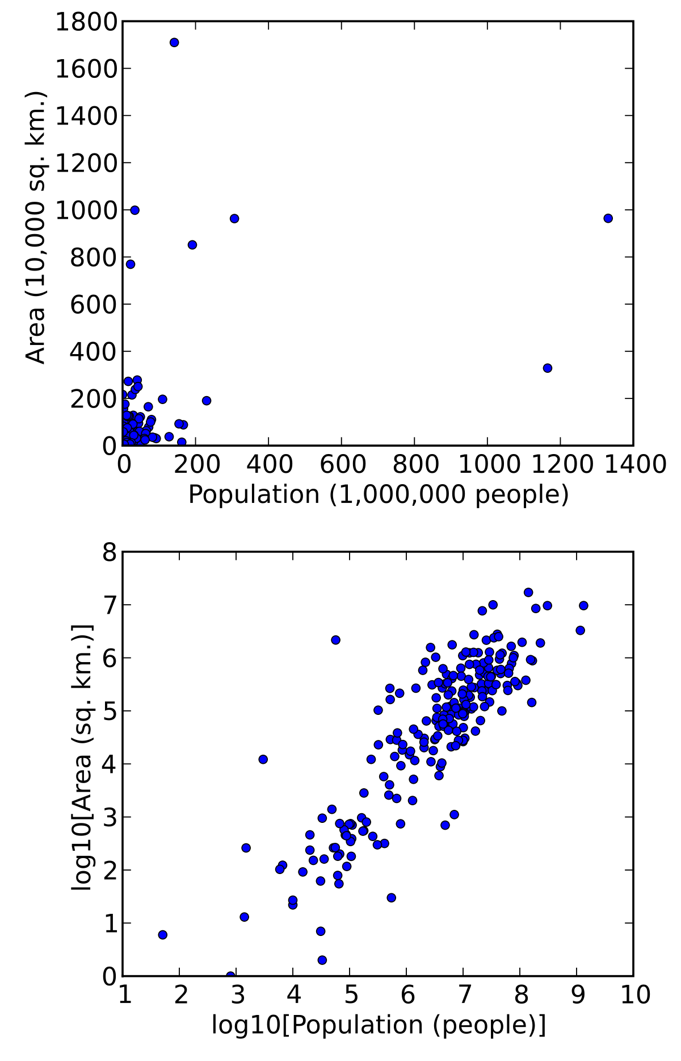
Prepare (Again)
Outliers
Transform Log transform
Value
Variable

Slide 51
Data Preparation: Feature Scaling
Prepare (Again)
Feature scaling is a method used to standardize the range of independent variables or features of data. In data processing, it is also known as data normalization and is generally performed during the data pre-processing step.
Common Methods:
Standard Scaler
MinMax Scaler
Robust Scaler

Slide 52
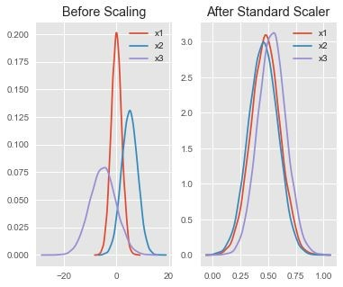
Feature Scaling: Standard Scaler
Prepare (Again)
Assumes your data is normally distributed within each feature and will scale them such that the distribution is now centred around 0, with a standard deviation of 1.
The mean and standard deviation are calculated for the feature and then the feature is scaled based on:
x_{i}–mean(x) stdev(x)
If data is not normally distributed, this is not the best scaler to use.

Slide 53
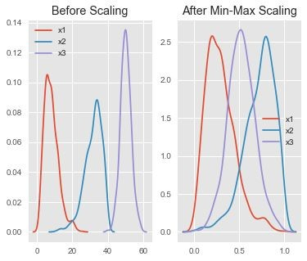
Feature Scaling: Min-Max Scaler
Prepare (Again)
One of the most well-known scaling algorithm, and follows the following formula for each feature:
x_{i}–min(x) max(x)–min(x)
It essentially shrinks the range such that the range is now between 0 and 1 (or -1 to 1 if there are negative values).
Works better than Standard Scaler for cases in which the distribution is not Gaussian or the standard deviation is very small
However, it is sensitive to outliers, so if there are outliers in the data, you consider the Robust Scaler.

Slide 54
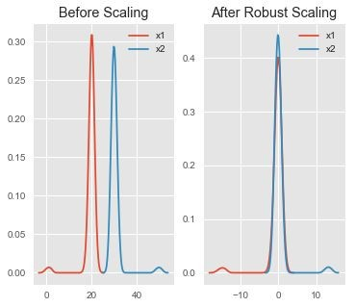
Feature Scaling: Robust Scaler
Prepare (Again)
Uses a similar method to the Min-Max scaler but it instead uses the interquartile range, rather than the min-max, so that it is robust to outliers.
Follows the formula:
x_{i}–Q₁(x) Q₃(x)–Q₁(x)
Notice that after Robust scaling, the distributions are brought into the same scale and overlap, but the outliers remain outside of bulk of the new distributions.

Slide 55
(Bivariate) Analysis
Profile
Prepare
Analyze
(again)

Slide 56
Bivariate (Analysis)
Univariate Analysis
Bivariate Analysis

Slide 57
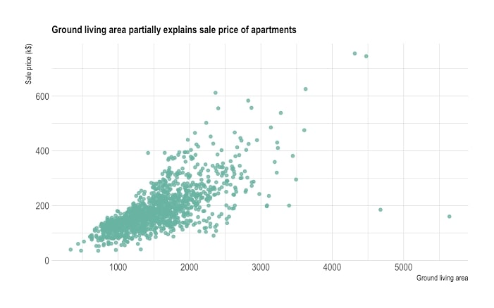
(Bivariate) Analysis
Charts: Scatterplot
Predicting house price given ground living area
Price (thousand dollars)
Ground living area

Slide 58
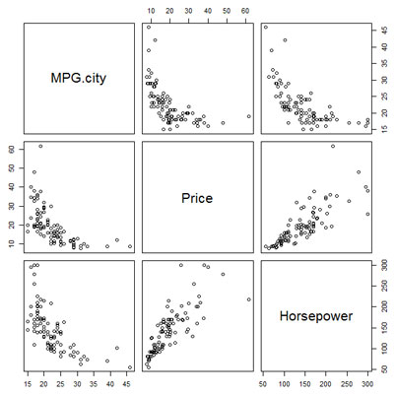
(Bivariate) Analysis
Charts: Scatterplot
Predicting car price given Horsepower and MPG (Miles per gallon)
Price and horsepower are correlated
MPG and horsepower are also correlated.
Test for Multicollinearity: Variance Inflation Factor
https://etav.github.io/python/vif_factor_python.html

Slide 59
Breakout Activity:
EDA

Slide 60
Breakout Activity: EDA
Each group will be provided a dataset and a business prompt. By our next session, each group will have prepared and explored their data set, and are ready to present initial findings/insights.
Part 1: Initial Discussion
25-30 mins.
Come together as a group, read through the prompt and look through the data
Consider the ff. Items:
What does each data point represent?
What is the business objective, and how does the data relate to it?
Part 2: “Stakeholder” Meeting
25-30 mins.
Each group will be assigned someone who will play the role of “stakeholder”. The group is expected to lead the discussion, asking questions that they prepared in Part 1 to help them with the rest of their activity.
Part 3: Analysis
Throughout the week, the group will do work on their dataset, doing data prep work and EDA (Univariate and Bivariate) to come up with initial insights.
The group can schedule up to one (1) additional 30-minute meeting with their “stakeholder”.
Part 4: Presentation
In our next session, each group will do a 3-5 slide presentation, outlining their business case, data, and their initial insights. The presentation should last ~5 minutes.

Slide 62
Introduction to
Modeling

Slide 63
Introduction
What comes to mind when we hear modelling
(in the data context)?

Slide 64


Introduction
Randomness
Deterministic Process
Stochastic Process

Slide 65

Introduction
Modelling
Coming up with mathematical representations of processes

Slide 66
Introduction
Modelling
Coming up with mathematical representations of processes
WHY DO WE WANT TO MODEL PROCESSES?

Slide 67


Introduction
Inference
Predictions
What is happening?
Why is it happening?
What patterns/relationships are manifesting?
What will happen/could happen?
How might certain interventions affect the outcomes?

Slide 68
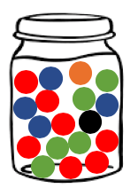
Introduction
Simple Models include distributions/frequency charts

Slide 69
(Generalized)
Linear Models

Slide 70
Linear Models
Linear Model:
Models some outcome as having a linear relationship with one or more predictors
Predictor, Regressor, Covariate, Independent Variable, X
Outcome, Response,
Dependent Variable, Y

Slide 71
Linear Models
Linear Model:
Models some outcome as having a linear relationship with one or more predictors
Outcome | Predictor
Exam Grades | Time Spent Studying
Average Weekly Rice Budget | Size of Family
Interest Rates | Inflation
Predictor, Regressor, Covariate, Independent Variable, Features, X
Outcome, Response,
Dependent Variable, Labels, Y

Slide 72
Linear Models
Linear Model:
Models some outcome as having a linear relationship with one or more predictors

Slide 73
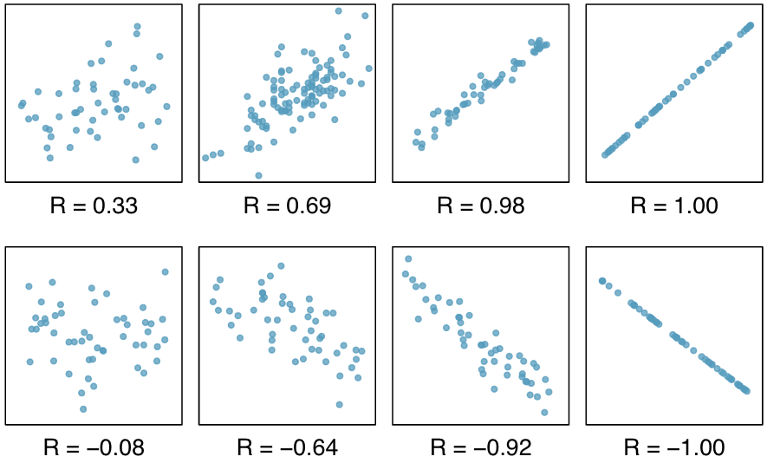
Linear Models
Linear Model:
Models some outcome as having a linear relationship with one or more predictors

Slide 74

Linear Models
Linear Model:
Models some outcome as having a linear relationship with one or more predictors

Slide 75
Linear Models
Linear Model:
Models some outcome as having a linear relationship with one or more predictors
Outcome | Predictor
Exam Grades | Time Spent Studying
Average Weekly Rice Budget | Size of Family
Interest Rates | Inflation
Exam Grade = 10 * Time Spent Studying + 10
Average Weekly Rice Budget = 50 * Size of Family + 0

Slide 76
Linear Models
Linear Model:
Models some outcome as having a linear relationship with one or more predictors
When building linear models, Y and X are data points - what you actually change and tinker around with are the parameters m and b (slope/s and intercept)
Exam Grade = 10 * Time Spent Studying + 10
Average Weekly Rice Budget = 50 * Size of Family + 0

Slide 77
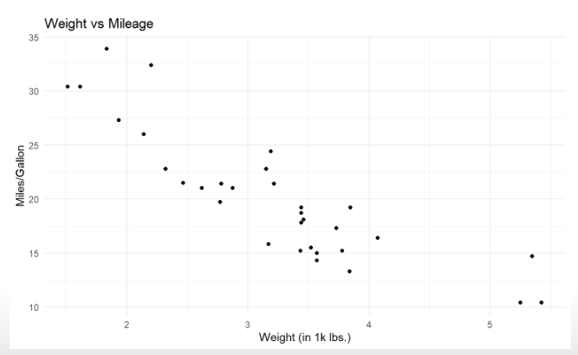
Linear Models
Suppose you’re working on a dataset of cars (mtcars), looking specifically at how a cars weight relates with its mileage per gallon

Slide 78
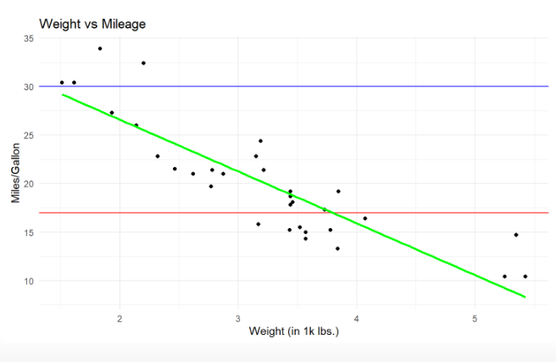
Linear Models
Suppose you’re working on a dataset of cars (mtcars), looking specifically at how a cars weight relates with its mileage per gallon
There are three colored lines, representing three different linear models
(Mileage = m * Weight + b)
Which one would you consider the best?

Slide 79
Linear Models

Slide 80
Linear Models
Generally, the “best fit line” is the one that minimizes its total distance from the actual data points

Slide 81
Linear Models
It turns out the linear models represented are:
Red: Y = 0 * X + 30
Blue: Y = 0 * X + 17
Green: Y = 5 * X + 37
(Where X is Weight, Y is Mileage per Gallon)
How can we use these for Inference?

Slide 82
Linear Models
It turns out the linear models represented are:
Red: Y = 0 * X + 30
Blue: Y = 0 * X + 17
Green: Y = 5 * X + 37
(Where X is Weight, Y is Mileage per Gallon)
Intercept: Value of Y when X is 0
Slope: For each unit increase in X, Y will increase by m

Slide 83
Linear Models
It turns out the linear models represented are:
Red: Y = 0 * X + 30
Blue: Y = 0 * X + 17
Green: Y = 5 * X + 37
(Where X is Weight, Y is Mileage per Gallon)
How can we use these for Prediction?

Slide 84
Linear Models
It turns out the linear models represented are:
Red: Y = 0 * X + 30
Blue: Y = 0 * X + 17
Green: Y = 5 * X + 37
(Where X is Weight, Y is Mileage per Gallon)
We can plug in different values of X (our predictors) to see the resulting values of Y.

Slide 85
Linear Models
Guided Exercises

Slide 86
Logistic Regression

Slide 87
Logistic Regression
Outcome | Predictor
Exam Grades | Time Spent Studying
Average Weekly Rice Budget | Size of Family
Interest Rates | Inflation
Predictor, Regressor, Covariate, Independent Variable, X
Outcome, Response,
Dependent Variable, Y

Slide 88
Logistic Regression
Outcome | Predictor
Exam Grades | Time Spent Studying
Average Weekly Rice Budget | Size of Family
Interest Rates | Inflation
INPUT
OUTPUT
Predictor, Regressor, Covariate, Independent Variable, X
Linear Model
Outcome, Response,
Dependent Variable, Y

Slide 89
Logistic Regression
Outcome | Predictor
Exam Grades | Time Spent Studying
Average Weekly Rice Budget | Size of Family
Interest Rates | Inflation
INPUT
OUTPUT
Predictor, Regressor, Covariate, Independent Variable, X
Linear Model
Outcome, Response,
Dependent Variable, Y

Slide 90
Logistic Regression
Outcome | Predictor
Exam Grades | Time Spent Studying
Average Weekly Rice Budget | Size of Family
Interest Rates | Inflation
INPUT
OUTPUT
Predictor, Regressor, Covariate, Independent Variable, X
Linear Model
Outcome, Response,
Dependent Variable, Y

Slide 91

Logistic Regression
LINEAR REGRESSION
Most types of structured input(s)
Real Value

Slide 92
Logistic Regression
LINEAR REGRESSION
Most types of structured input(s)
Real Space
What if we want to predict an outcome that isn’t in covered by the Real Space?

Slide 93
Logistic Regression
Recall the titanic dataset, with its SURVIVED column (0/1 for No/Yes Respectively).
If we wanted to build a linear model to relate survival with the other variables in the dataset, is it enough to use Linear Regression?

Slide 94

Logistic Regression
GENERALIZED LINEAR MODEL
Generalizes the linear model framework by allowing the response variable to be related to the linear model via a LINK FUNCTION (e.g. f(.)) such that:

Slide 95

Logistic Regression
GENERALIZED LINEAR MODEL
Generalizes the linear model framework by allowing the response variable to be related to the linear model via a LINK FUNCTION (e.g. f(x)) such that:
For linear regression, the link function is the identity link:

Slide 96
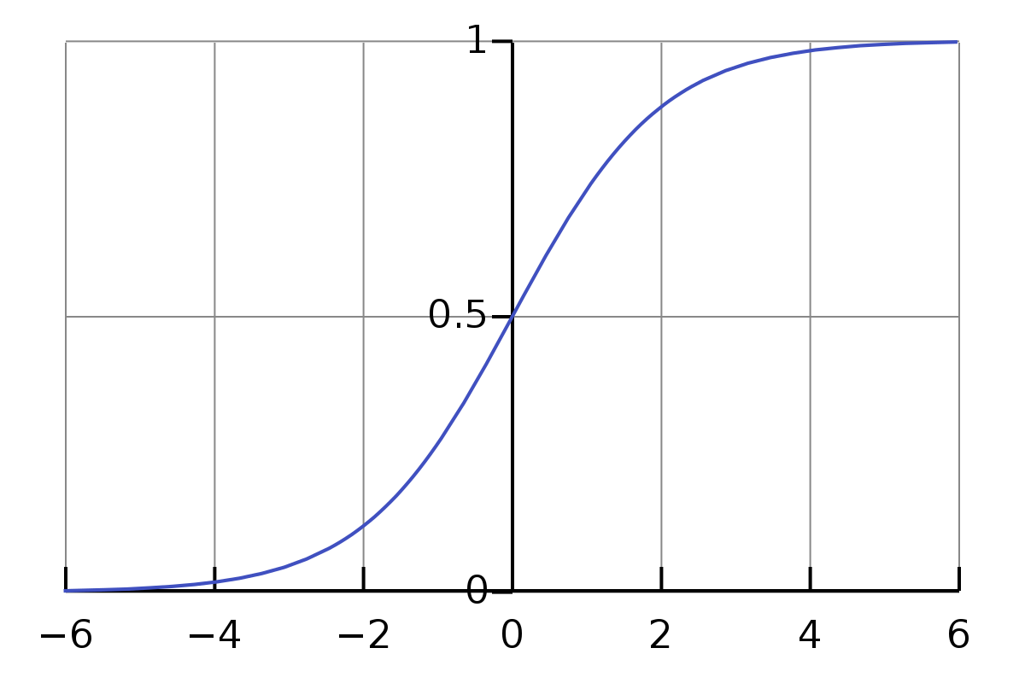
Logistic Regression
To do linear modelling on outcomes that are binary, we need a link function that maps the REAL SPACE (as input) into the PROBABILITY SPACE [0, 1]:
Any Real Number (-inf, +inf)
Probability Space (0, 1)

Slide 97
Linear Models
Guided Exercises

